Slide 1

Sora
Video generation models
as world simulators
温家振：PPT制作
周同阳：脚本撰写
王昱硕：视频剪辑 章鹏程：中英解说

Slide 2
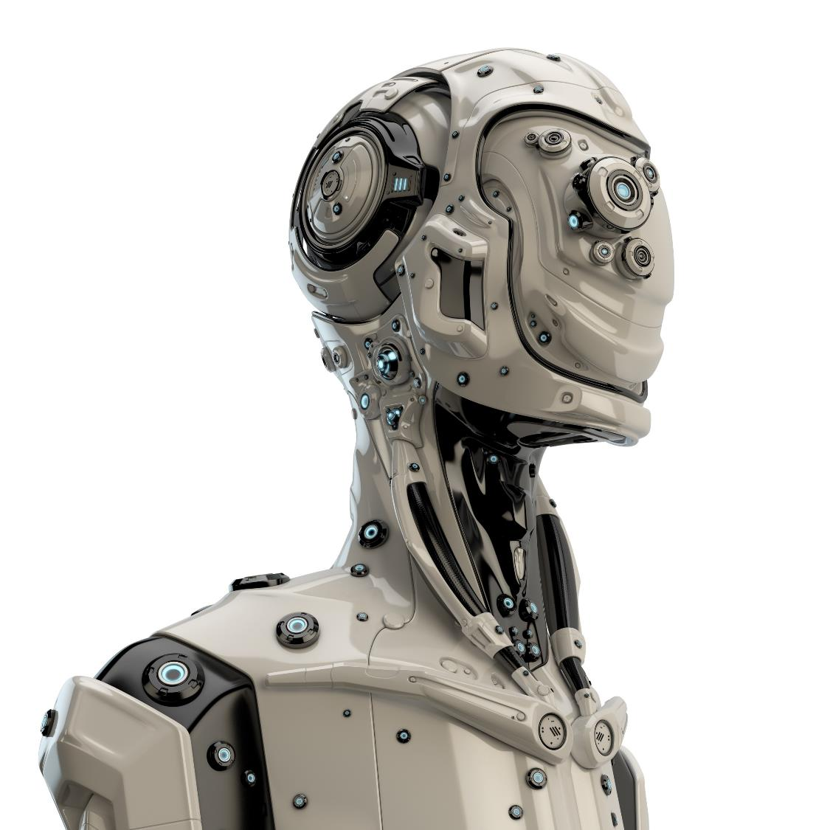
2.Research about Sora
CONTENTS
1.What is Sora
3.How can we use Sora
4.What Does Sora Mean for the Future

Slide 3
1.What is Sora
CHAPTER ONE
Sora

Slide 4
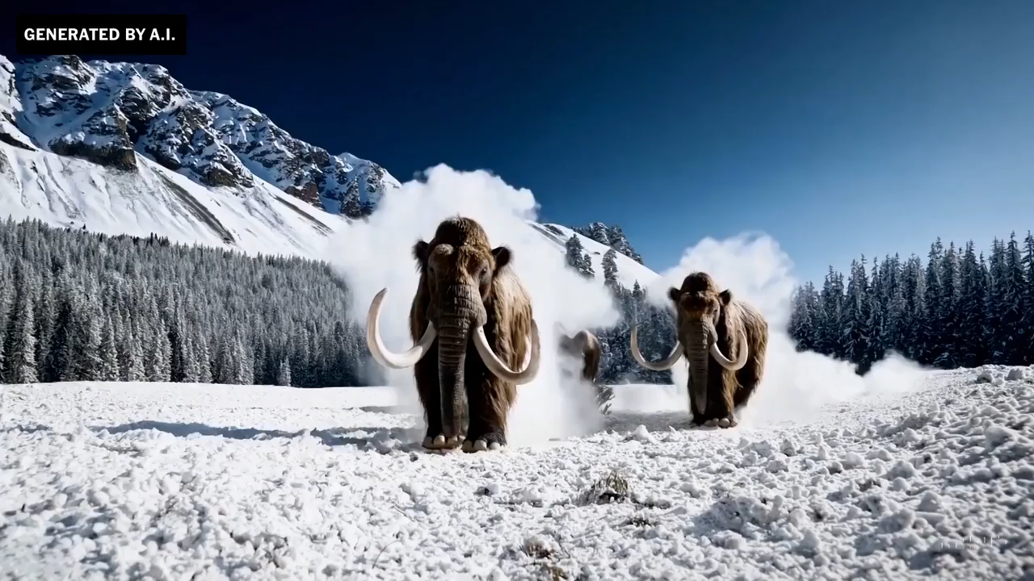
Part 1
What is Sora?
Sora is OpenAI's text-to-video generative AI model. That means you write a text prompt, and it creates a video that matches the description of the prompt. Here's an example from the OpenAI site:
Notes:
Sora is an AI model developed by OpenAI that can create realistic and imaginative videos from text instructions. It understands and simulates the physical world in motion, generating videos up to a minute long while maintaining visual quality and adhering to the user’s prompts1. Sora represents a significant advancement in AI’s capacity to produce audiovisual material, with potential applications in entertainment, education, and simulation.

Slide 5
2. Research about Sora
CHAPTER ONE
Sora

Slide 6

Part 2
Theoretical Basis
Like text-to-image generative AI models such as DALL·E 3, Stable Diffusion, and Midjourney, Sora is a diffusion model. That means that it starts with each frame of the video consisting of static noise, and uses machine learning to gradually transform the images into something resembling the description in the prompt.
行业PPT模板http://www.1ppt.com/hangye/
Notes:
We train a network that reduces the dimensionality of visual data.²⁰ This network takes raw video as input and outputs a latent representation that is compressed both temporally and spatially. Sora is trained on and subsequently generates videos within this compressed latent space. We also train a corresponding decoder model that maps generated latents back to pixel space.

Slide 7
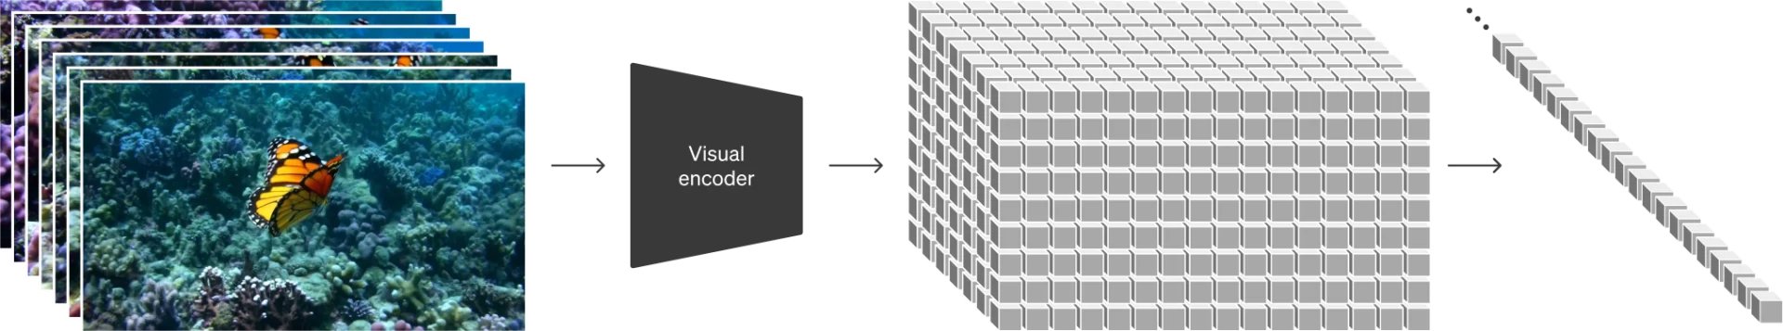
Part 2
Research Method
The Sora model is built on the Diffusion Transformer (DiT) framework, combining the strengths of Transformers and diffusion models. It employs a Variational Autoencoder (VAE) encoder, a Vision Transformer (ViT), a Denoising Diffusion Probabilistic Model (DDPM), and a VAE decoder to achieve text-to-video transformation.
行业PPT模板http://www.1ppt.com/hangye/
Notes:
We train a network that reduces the dimensionality of visual data.²⁰ This network takes raw video as input and outputs a latent representation that is compressed both temporally and spatially. Sora is trained on and subsequently generates videos within this compressed latent space. We also train a corresponding decoder model that maps generated latents back to pixel space.

Slide 8
Part 2
Research Process
Video data collection and annotation
Data is collected from a large number of videos and annotated to provide a basis for models to learn and understand visual content.
Data is collected from a large number of videos and annotated to provide a basis for models to learn and understand visual content.
Image subtitle model training
GPT-4 Rich video description
Use GPT-4 model to improve the quality and detail of video description, making the description more comprehensive and detailed.
Video segmentation into Patches
Segments processed video into small Patches called "video patches" to focus on each detail and lay a foundation for learning and generation.

Slide 9
Part 2
Research Process
Video compression model application
Video Patches are processed with video compression models to convert to efficient potential Spaces, simplifying subsequent processing and learning processes.
Video data processing in latent space
Compressed data is used to generate new video in latent space.
Diffusion model and Transformer training
The diffusion model and Transformer structure are combined to conduct training on the potential space. Text description and patches with random noise are input to output the manifestation form of video in the potential space.
Video recovery
Use a video decoding model to map underlying features back into pixel space to get HD video.

Slide 10
Part 2
Research Found
The Found from Sora’s research indicate that the model can understand complex text descriptions and convert them into high-quality video content. Its emergence heralds a new era in AI’s capabilities for visual content creation and simulating the real world.

Slide 11
3.How can we use Sora
CHAPTER THREE
Sora

Slide 12
Part 3
How can we use Sora
Sora can be used to create videos from scratch or extend existing videos to make them longer. It can also fill in missing frames from videos.In the same way that text-to-image generative AI tools have made it dramatically easier to create images without technical image editing expertise, Sora promises to make it easier to create videos without image editing experience. Here are some key use cases.

Slide 13

Part 3
Social media
Sora can be used to create short-form videos for social media platforms like TikTok, Instagram Reels, and YouTube Shorts. Content that is difficult or impossible to film is especially suitable. For example, this scene of Lagos in 2056 would be technically difficult to film for a social post but is easy to create using Sora.
Advertising and marketing
Creating adverts, promotional videos, and product demos is traditionally expensive. Text-to-video AI tools like Sora promise to make this process much cheaper. In the following example, a tourist board wanting to promote the Big Sur region of California could rent a drone to take aerial footage of the location, or they could use AI, saving time and money.

Slide 14
4.What Does Sora Mean for the Future
CHAPTER FOUR
Sora

Slide 15
Part 4
Industry Transformation
Simulation Capabilities
Sora is expected to revolutionize industries by enabling the creation of realistic video content from text, transforming how we produce and interact with digital media.
It will play a pivotal role in simulating physical and digital worlds, enhancing the realism of virtual environments and potentially changing the landscape of video games and simulations.
Investment & Development
Ethical Considerations
The emergence of Sora will likely accelerate investments in the multi-modal AI field and drive demand for increased computing power, benefiting companies that specialize in AI hardware.
While Sora will be safeguarded upon release, it raises questions about misinformation spread and the ethical use of AI-generated content. Future text-to-video algorithms may present challenges due to potential exploitation risks.

Slide 16
Thanks!
THANKS FOR YOUR WATCHING
Sora

